Slide 1
K-Nearest Neighbour
Session 22
Henry Lucky, S.Kom., M.Kom.

Slide 2
Learning Outcomes
Session 22
At the end of this session, students will be able to:
LO 5: Apply various learning algorithms for agents to solve problems

Slide 3
outline
Session 22
Instance Based Learning
Non-parametric model
K-Nearest Neighbour

Slide 4
Instance-based Learning
Lazy vs. Eager Learning
Lazy vs. eager learning
  Lazy learning (e.g., instance-based learning): Simply stores training data (or only minor processing) and waits until it is given a test tuple
  Eager learning: Given a set of training tuples, constructs a classification model before receiving new (e.g., test) data to classify
Lazy: less time in training but more time in predicting
Accuracy
  Lazy method effectively uses a richer hypothesis space since it uses many local linear functions to form an implicit global approximation to the target function
  Eager: must commit to a single hypothesis that covers the entire instance space

Slide 5
Instance-based Learning
Definition
Instance-based learning:
  Store training examples and delay the processing (“lazy evaluation”) until a new instance must be classified
Typical approaches
  k-nearest neighbor approach
    Instances represented as points in a Euclidean space.
  Locally weighted regression
    Constructs local approximation
  Case-based reasoning
    Uses symbolic representations and knowledge-based inference

Slide 6
Non-parametric model
Definition
A non-parametric model is a type of model used in statistics and machine learning that does not assume any specific form for the relationship between independent and dependent variables.
Unlike parametric models, which are characterized by a finite set of parameters and a predetermined functional form, non-parametric models are more flexible as they do not require the underlying distribution or structure to be defined in advance.
This flexibility allows non-parametric models to adapt to the shape of the data, making them particularly useful when there is little or no prior knowledge about the distribution of the data or when the data structure is complex and does not fit well with common parametric models.

Slide 7
Non-parametric model
example
There are several types of non-parametric models used in various statistical and machine learning tasks. Some common examples include:
  Kernel Density Estimation (KDE):A non-parametric way to estimate the probability density function of a random variable.
  K-Nearest Neighbors (KNN): A simple algorithm that stores all available cases and classifies new cases based on a similarity measure (e.g., distance functions).
  Decision Trees: A model that predicts the value of a target variable by learning simple decision rules inferred from the data features.

Slide 8
K-nearest neighbor
definition
All instances correspond to points in the n-D space
The nearest neighbor are defined in terms of Euclidean distance, dist(X1, X2)
Target function could be discrete- or real- valued
For discrete-valued, k-NN returns the most common value among the k training examples nearest to xq

Slide 9
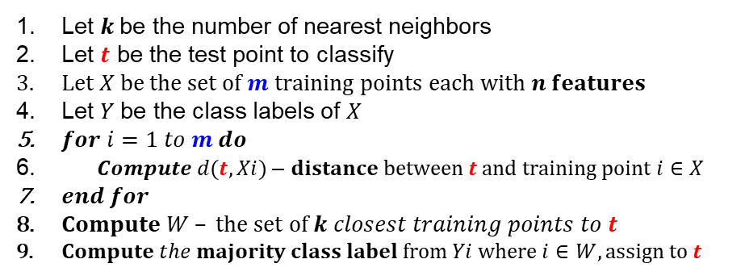
K-Nearest neighbor
Algorithm

Slide 10
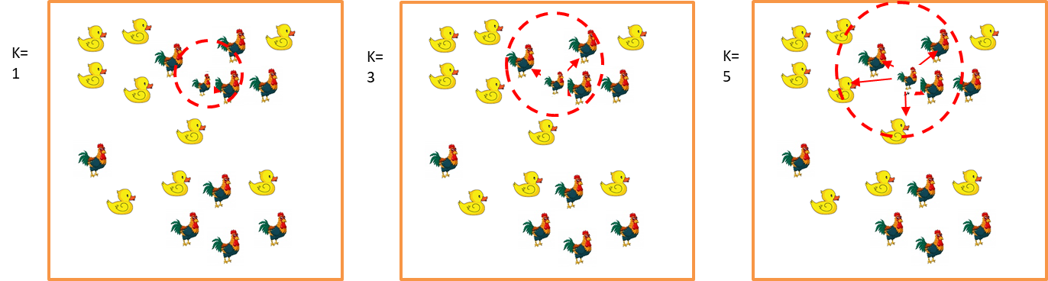
K-Nearest neighbor
Algorithm

Slide 11
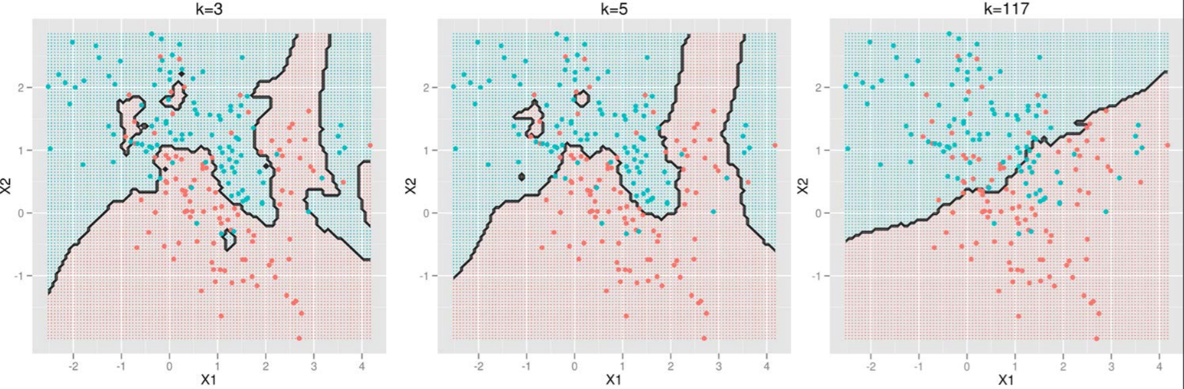
K-nearest neighbor
Selection of k for k-NN
The number of neighbors k should be odd
Small k: overfitting (high variance, low bias)
Big k: bringing too many irrelevant points (high bias, low variance)
Source: http://scott.fortmann-roe.com/docs/BiasVariance.html

Slide 12
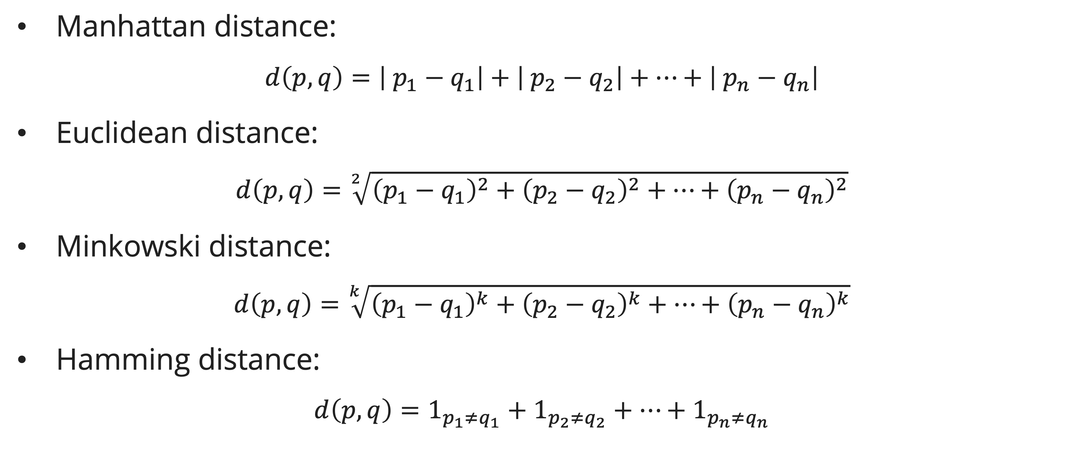
K-nearest neighbor
Distance metrics
Manhattan distance:
$$d\left(p, q\right)=\left| p_{1}−q_{1}\right|+\left| p_{2}−q_{2}\right|+…+\left| p_{n}−q_{n}\right|$$
Euclidean distance:
$$d\left(p, q\right)=\sqrt[2]{{\left(p_{1}−q_{1}\right)}^{2}+{\left(p_{2}−q_{2}\right)}^{2}+…+{\left(p_{n}−q_{n}\right)}^{2}}$$
Minkowski distance:
$$d\left(p, q\right)=\sqrt[k]{{\left(p_{1}−q_{1}\right)}^{k}+{\left(p_{2}−q_{2}\right)}^{k}+…+{\left(p_{n}−q_{n}\right)}^{k}}$$
Hamming distance:
$$d\left(p, q\right)=1_{p_{1}≠q_{1}}+1_{p_{2}≠q_{2}}+…+1_{p_{n}≠q_{n}}$$

Slide 13
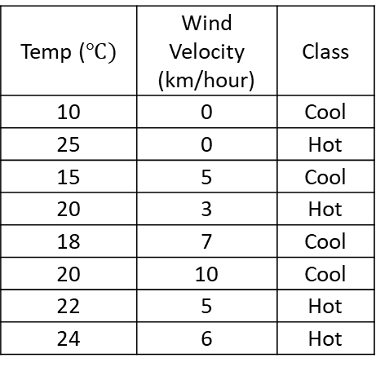
K-nearest neighbor
Example
Find the class when temp = 16 and wind velocity = 3

Slide 14
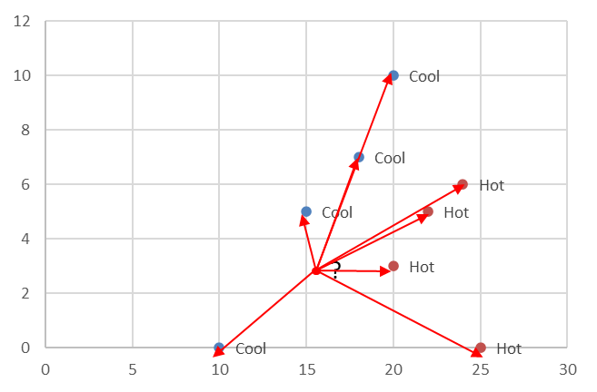
K-nearest neighbor
Example
Let’s say K = 3
Calculate the distance of the new object to all points (data)

Slide 15
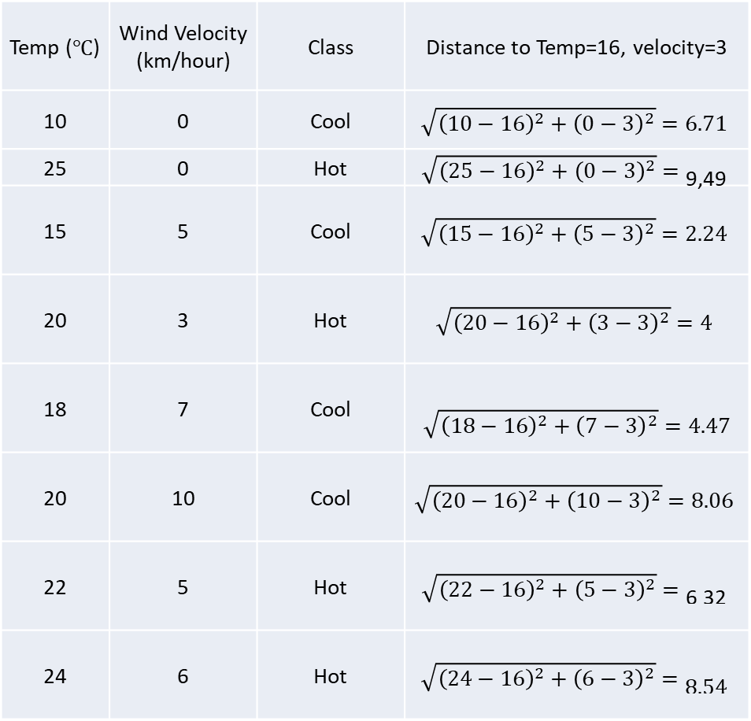
K-nearest neighbor
Example

Slide 16
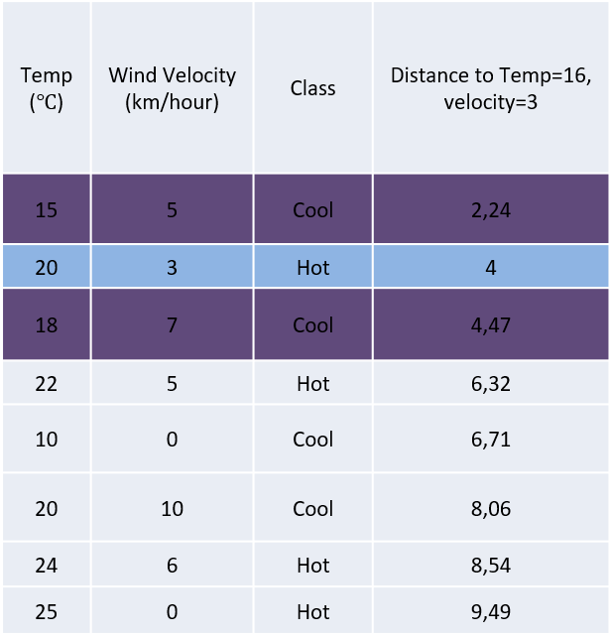
K-nearest neighbor
Example
Let’s say k = 3
Calculate the distance of the new object to all points (data)
Sort distance from the nearest to the farthest.
Choose the first 3 nearest neighbors
Assign new object to the class which appears more frequently (Cool)

Slide 17

K-nearest neighbor
discussion
k-NN for real-valued prediction for a given unknown tuple
  Returns the mean values of the k nearest neighbors
Distance-weighted nearest neighbor algorithm
  Weight the contribution of each of the k neighbors according to their distance to the query xq
    Give greater weight to closer neighbors
Robust to noisy data by averaging k-nearest neighbors
Curse of dimensionality: distance between neighbors could be dominated by irrelevant attributes
  To overcome it, axes stretch or elimination of the least relevant attributes
$$w=\frac{1}{d(x_{q},x_{i})^{2}}$$

Slide 18
Exercise
Session 22
Find the class, if it is known that a person has a height of 170 cm and a weight of 55 kg

Slide 19
References
Session 22
Areibi, S. (n.d.). K-Nearest Neighbor [Lecture in Advanced Machine Learning].
James, G., Witten, D., Hastie, T., Tibshirani, R., & Taylor, J. (2023). An introduction to statistical learning: With applications in Python. Springer.
Raschka, S. (2018). Nearest Neighbor Method. STAT 479: Machine Learning Lecture Notes. https://sebastianraschka.com/pdf/lecture-notes/stat479fs18/02_knn_notes.pdf

